Slide 1
Web Accessibility
Becoming Proactive

Slide 2
Outline
Introduction to Web Accessibility
  What Is Web Accessibility
  What Makes Something Accessible
  Why Be Accessible
  Who Should We Be Accessible For
  Who Should We Make Things Accessible For
The First Steps (Understanding the User)
  Disabilities
  Assistive Technology
Making A Difference
  WCAG 2.0
Working with Code
What Do We Do

Slide 3
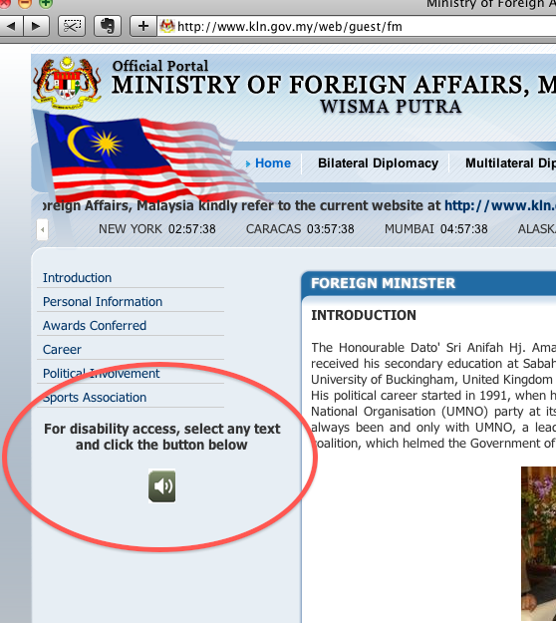
What Is Web Accessibility
Web accessibility refers to the inclusive practice of removing barriers that prevent access to websites by people with disabilities.
We should extend this to removing barriers for anyone.
The practice of making sure everyone can properly access a website.
Notes:
http://www.w3.org/WAI/demos/bad/before/home.html#page

Slide 4
What Makes Something Accessible
How many would say a website you recently created was accessible?
  What if a person using it is blind?
  What if a person using it has low to no mobility of their hands?
To be accessible, something has to be able to be used successfully by everyone, no matter what disability a person has or doesn’t have.
Ask yourself, if a person with ______ was using this site/app, could they successfully use it to do the goal of the site/app.

Slide 5
Why Be Web Accessible?
Ethical Responsibility
Legal Responsibility
  The law states we have to be accessible for “qualified individuals”.
    Qualified individuals include students, prospective students, and almost anyone using our web sites.
  The law also states we have to give every student the same chance at success.
  When sites are correctly designed, developed and edited, all users have equal access to information and functionality and that makes everyone happy.

Slide 6
A Trend In Higher Education
During the past five years inaccessible Information Technology (IT) has increasingly impacted higher education.
Louisiana Tech, South Carolina Technical College System, University of Montana, Florida State University, Northwestern University, New York University, Penn State University, Law School Admissions Council, Arizona State, Princeton, Reed, Pace, Darden School of Business, and Case Western have all faced litigation for inaccessible Web content and technologies.

Slide 7
Top Issues
Websites
  Missing Alt attributes on images
  Missing labels on form fields
  Improper markup on data tables (td, th, tr)
  Inaccessible image maps
Purchased Technologies
  The technology doesn’t support screen readers
  Videos are not close captioned

Slide 8
Laws and Regulations
Section 504 of rehabilitation act
  If we receive any federal funds/grants anywhere throughout the university we have to follow Section 504 of the Rehabilitation Act.
  There shall be no discrimination to people with disabilities.
ADA Title II
  May not refuse to allow a person with a disability to participate in a service, program, or activity simply because the person has a disability.
Section 508 of rehabilitation act
  Federal agencies have to make sure they procure technology that is accessible.
  All procured technology must follow a set of guidelines.
  This goes for federal agencies but most states have this law verbatim in their law.
Web Content Accessibility Guidelines (WCAG)

Slide 9
Who Should We Make Things Accessible For?
Simple answer is everyone
Have special consideration for the needs of people with disabilities
  Visual
  Hearing
  Motor
  Cognitive
  Seizures, etc.
Situational Disabilities exist for everyone and making things more accessible makes it easier for everyone

Slide 10
The First Steps
Understanding the Users

Slide 11
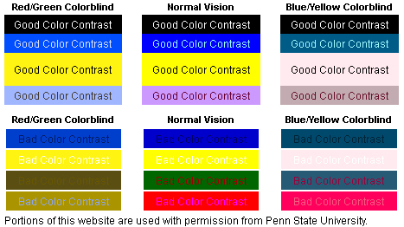
Visual Disabilities
Disabilities
  Blindness, low vision, color-blindness, dyslexia, etc.
Situational Disabilities
  Color issues with a monitor

Slide 12
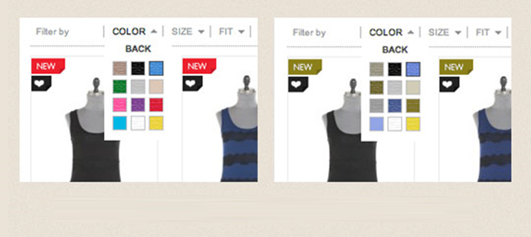
Visual Disabilities

Slide 13
Hearing Disabilities
Disabilities
  Deafness
  hard-of-hearing
Situational Disabilities
  Background Noise
  No headphones
  Speakers broken
https://www.youtube.com/watch?v=sdEk4P3kQb0

Slide 14
Motor Skill Disabilities
Challenges | Solutions
Users may not be able to use the mouse. | Make sure that all functions are available from the keyboard (try tabbing from link to link).
Users may not be able to control the mouse or the keyboard well. | Make sure that your pages are error-tolerant (e.g. ask "are you sure you want to delete this file?"), do not create small links or moving links.
Users may be using voice-activated software. | Voice-activated software can replicate mouse movement, but not as efficiently as it can replicate keyboard functionality, so make sure that all functions are available from the keyboard.
Users may become fatigued when using "puff-and-sip" or similar adaptive technologies. | Provide a method for skipping over long lists of links or other lengthy content.
Inability to use a mouse, slow response time, limited fine motor control
Situational Disabilties?

Slide 15
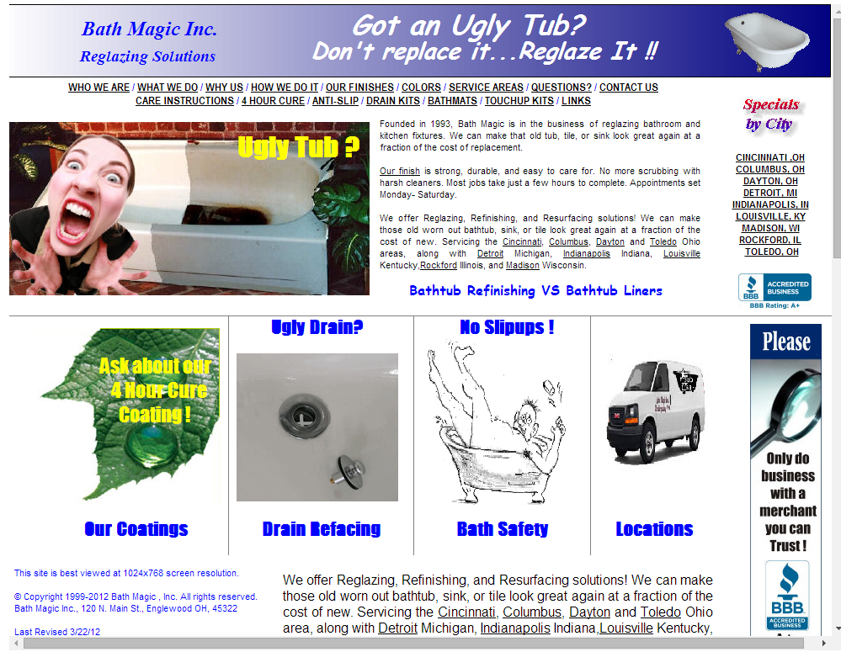
Cognitive Disabilities
Learning disabilities, distractibility, inability to remember or focus on large amounts of information
Situational Disabilities?

Slide 16
Understanding Assistive Technology (AT)
Any item, piece of equipment, software or product system that is used to increase, maintain, or improve the functional capabilities of individuals with disabilities
There are people who use our applications with AT and we need to make sure our applications work well with AT.
We must take into consideration how these types of technology work, so we can understand how to better provide for those who use them
Examples of widely used AT:
  Screen Readers (JAWS, NVDA, etc.)
  Mouth stick, head wand, single-switch, sip and puff switch
  Eye tracking
  Voice recognition software

Slide 17
Screen Readers (a focus on JAWS)
JAWS is the go to screen reader for people with visual disabilities
Student Accessibility Services (SAS) uses JAWS and that is what we tested with
JAWS does a great job screen reading but can only read what we give it to read
Important to properly use alt text, titles, labels, headers, and proper anchors.

Slide 18
How JAWS Reads
Order
  Reads browser information and page title
  Reads how many headers and links are in the body
  Reads the body from beginning to end

Slide 19
How JAWS Reads
What Jaws Tells a User
  JAWS will tell a user if something is a link, image, button, form input and the heading level
  JAWS however, does not pick up on things like onclick events being “links”. A developer must use hrefs (even with #) for it to pick up as a link
  If something isn’t picked up as a link, a user has no way of navigating to it

Slide 20
User Navigation
A user uses the Tab and arrow keys to navigate through the page.
The tab key will move a user through links and the arrow keys will move a user from header to header, to paragraphs, and through words.

Slide 21
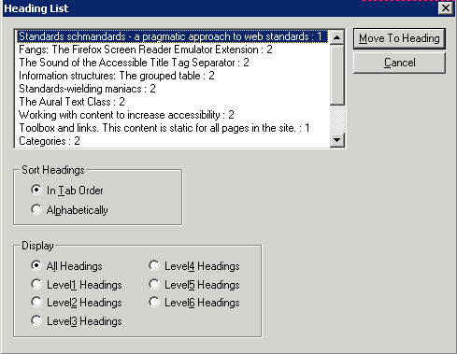
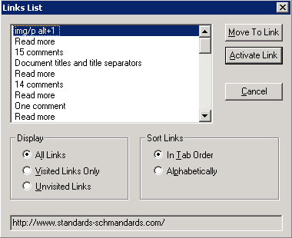
User Navigation
Jaws also automatically builds out a heading and link list which users can use to navigate to sections of the page or activate links.

Slide 22
Making a Difference
Understanding what we can do and how to do it

Slide 23
What is WCAG 2.0 AA
WCAG 2.0 AA
  It is not a law or regulation but a set of guidelines.
  Everything is moving towards WCAG 2.0 AA Globally
    At some point New Section 508 standards will follow WCAG 2.0 AA guidelines
  New Developments in ADA Regulations for Web are coming
    Will most likely be based off of WCAG 2.0 AA
  Can Easily be tested using automated tools

Slide 24
Main Principles of WCAG
Perceivable
  Available to the senses (vision and hearing primarily)
  Either through the browser or through assistive technologies (e.g. screen readers, screen enlargers, etc.)
Operable
  Users can interact with all controls and interactive elements using either the mouse, keyboard, or an assistive device.
Understandable
  Content is clear and limits confusion and ambiguity.
Robust
  A wide range of technologies (including old and new user agents and assistive technologies) can access the content.

Slide 25
Accessible Design Principles
Provide appropriate alternative text
  Alternative text provides a textual alternative to non-text content in web pages.
  It is especially helpful for people who are blind and rely on a screen reader to have the content of the website read to them.
Provide appropriate document structure
  Headings, lists, and other structural elements provide meaning and structure to web pages.
  They can also facilitate keyboard navigation within the page.
Provide headers for data tables
  Tables that are used to organize tabular data should have appropriate table headers (the <th> element).
  Data cells should be associated with their appropriate headers, making it easier for screen reader users to navigate and understand the data table.
Ensure users can complete and submit all forms
  Ensure that every form element (text field, checkbox, dropdown list, etc.) has a label and make sure that label is associated to the correct form element using the <label> element.
  Also make sure the user can submit the form and recover from any errors, such as the failure to fill in all required fields.

Slide 26
Accessible Design Principles
Ensure links make sense out of context
  Every link should make sense if the link text is read by itself.
  Screen reader users may choose to read only the links on a web page. Certain phrases like "click here" and "more" must be avoided.
Caption and/or provide transcripts for media
  Videos and live audio must have captions and a transcript.
  With archived audio, a transcription may be sufficient.
Ensure accessibility of non-HTML content, including PDF files, Microsoft Word documents, PowerPoint presentations and Adobe Flash content.
  In addition to all of the other principles listed here, PDF documents and other non-HTML content must be as accessible as possible.
  If you cannot make it accessible, consider using HTML instead or, at the very least, provide an accessible alternative.
  PDF documents should also include a series of tags to make it more accessible. A tagged PDF file looks the same, but it is almost always more accessible to a person using a screen reader.

Slide 27
Accessible Design Principles
Allow users to skip repetitive elements on the page
  You should provide a method that allows users to skip navigation or other elements that repeat on every page.
  This is usually accomplished by providing a "Skip to Main Content," or "Skip Navigation" link at the top of the page which jumps to the main content of the page.
Do not rely on color alone to convey meaning
  The use of color can enhance comprehension, but do not use color alone to convey information.
  That information may not be available to a person who is colorblind and will be unavailable to screen reader users.
Make sure content is clearly written and easy to read
  There are many ways to make your content easier to understand. Write clearly, use clear fonts, and use headings and lists appropriately.

Slide 28
Accessible Design Principles
Make JavaScript accessible
  Ensure that JavaScript event handlers are device independent (e.g., they do not require the use of a mouse) and make sure that your page does not rely on JavaScript to function.
Design to standards
  HTML compliant and accessible pages are more robust and provide better search engine optimization. Cascading Style Sheets (CSS) allow you to separate content from presentation. This provides more flexibility and accessibility of your content.

Slide 29
Working With Code
What we learned from JAWS

Slide 30
Things to do to help make things more accessible
Meaningful alt attributes and links
  This helps blind users using text-to-speech software and/or text-to-Braille hardware.
Differentiated links (underlined, colored (proper), etc.)
  This ensures that color blind users will be able to notice them.
Large clickable links, buttons, areas, etc.
  This helps users who cannot control a mouse with precision.
Coding so that users can navigate by means of the keyboard alone, or a single switch access device alone
  This helps users who cannot use a mouse or even a standard keyboard.
Increasing the session time out time to accommodate users who will take longer to fill out forms because of disabilities.

Slide 31
Working With Code and JAWS
Links
  Clearly identify the target of each link
  Use a title attribute that clearly and accurately describes the target link
  If more than one link shares the same link text make sure title attribute is different
  All links must have href. This allows users to tab over to them and for it to pick up they are links
  If links share the same link text, point them to the same resource or change the link text.

Slide 32
Working With Code and JAWS
Links

Slide 33
Working With Code and JAWS
Images
  Developers need to include a text equivalent for every non-text element.
  This is done using the alt tag, but can also be done using longdesc, or in element content.
  You do not have to include any words like “an image of” because Jaws will tell a user that it is an image if it inside <img> markup.

Slide 34
Working With Code and JAWS
Images
In both situations above title does not have to be included because something does the same job as a tittle attribute. Having a title attribute would be redundant.

Slide 35
Working With Code and JAWS
Headings
  Users who use screen readers rely heavily on headings to navigate and to understand page organization
  Headings (h1, h2, etc.) should be used accurately to help a user

Slide 36
Working With Code
Headings

Slide 37
Working With Code
Forms and Labels
  Jaws has the ability to detect a form and switches modes to read it properly so it is important to properly set up form
  Labels should be used for input.
  <label for=””> should be used to make it easier for a user to select and understand checkboxes, radio buttons, etc

Slide 38
Working With Code
Forms and Labels

Slide 39
ARIA
Accessible Rich Internat Applications (ARIA) is a way of adding code snippets to your html and javascript to help users using screen readers better access your web content and applications.
Things like form roles, hints and error messages, along with a lot more can be added to code easily.
Examples below: more information and code at http://www.w3.org/TR/2010/NOTE-WCAG20-TECHS-20101014/aria.html

Slide 40
ARIA Example
Example:
With message pop we ran into an issue with it not being read by the screen reader.
Why the issue?
  It was being appended at the end of the body and the ready was never getting to it.
  It also wasn’t being picked up as any kind of alert because by nature it is just a colored div.
The Solution?
  Code was changed so it was prepended to the beginning of the body so it is the first thing read by the screen reader
  We used ARIA’s role=alert feature so screen readers would read the div as an alert to notify user that there was something that needed attention.

Slide 41
ARIA Example

Slide 42
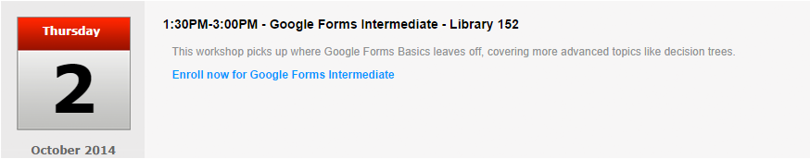
ARIA Example
Without Aria Label
<a href="enroll.php?courseid=26&filter=all">Enroll now for Google Forms Intermediate</a>
With Aria Label
<a href="enroll.php?courseid=26&filter=all" aria-label="Enroll now for Google Forms Intermediate on Thursday October 2 at 1:30PM">Enroll now for Google Forms Intermediate</a>

Slide 43
What Do We Do
Tying it all together

Slide 44
Simply…
Do not make or buy anything that does not allow a person with a disability to use it or have an alternative to using it that gives them the same advantage/usage (use it with the help of assistive technology, call instead of using a website)
  Develop applications that are accessible
    WCAG 2.0 AA Compliance
  Procure technology that is accessible
Make things accessible and easy to use for everyone
  Design and build our apps with all possible users in mind
  Test apps for accessibility (process on next slide)
Make sure we contribute to complete “program access” to people with disabilities

Slide 45
Process for Testing Accessibility
Code with accessibility in mind
Check your site against WCAG 2.0 Checklist
Test your code using the WAVE Firefox Toolbar
    Download at https://addons.mozilla.org/en-us/firefox/addon/wave-toolbar/
Make changes based on what the test says
Test with NVDA screen reader (free screen reader) and make changes if needed
Take the product to Student Accessibility Services (SAS) to be tested with a JAWS screen reader and get recommendations
Make changes based on SAS testing (repeat step 4 if needed)
Seek SAS signature that product was tested and approved*

Slide 46
Sources
http://webaim.org/
http://en.wikipedia.org/wiki/Web_accessibility

