Slide 1
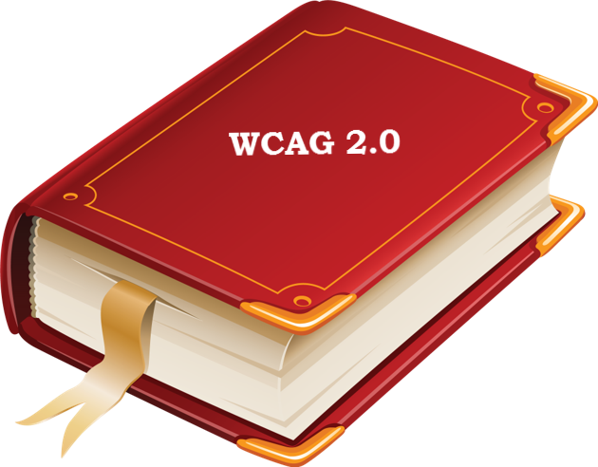
Section 508 Refresh

Slide 2
What is Different: Overview
Original Section 508 (2000)
Revised Section 508 (2017)
Organized by Subparts:
General
Technical Standards
  1194.21 thru 1194.26
FPC
Information, Documentation, and Support
Organized by Chapter:
Application & Administration (508 & 255)
Scoping Requirements
(508 & 255)
FPC
Hardware
Software
Support Documentation & Services
Referenced Standards

Slide 3

Other Changes
Exceptions
Added Important New
  E202.2 Legacy ICT
  (Safe Harbor)
Most Retained
  Two trivial ones were dropped
Extensive use of IBR
  WCAG 2.0
  PDF/UA
  others…
Covers Documents
More Definitions
Added FPC
Mobile addressed in Hardware and Software chapters

Slide 4
FPC: What Was Added?
Original 508 (2000)
Revised 508 (2017)
§ 1194.31 Functional Performance Criteria Require usability:
  Without vision
  With limited vision
  Without hearing
  With limited hearing
  Without speech
  Without fine motor or with limited reach and strength
302.1 Without Vision
302.2 With Limited Vision
302.3 Without Perception of Color
303.4 Without Hearing
303.5 With Limited Hearing
303.6 Without Speech
303.7 With Limited Manipulation
303.8 With Limited Reach and Strength
303.9 With Limited Language, Cognitive, and Learning Abilities

Slide 5
Documentation and Support
Original 508 (2000)
Revised 508 (2017)
§ 1194.41 Information, documentation, and support
Product support documentation must be available in alternative formats
End-users must have access to accessibility and compatibility features
Support services must accommodate communication needs
602 Support Documentation
602.2 Accessibility and Compatibility Features
602.3 Electronic Support Documentation
602.4 Alternate Formats for Non-Electronic Support Documentation
603 Support Services
603.2 Information on Accessibility and Compatibility Features
603.3 Accommodation of Communication Needs

Slide 6

Where to Go for More Details?
Final Regulatory Impact
Analysis
Table A-1. WCAG 2.0 Level A and Level AA Success Criteria
Table A-2. Final Rule Requirements for Software
Table A-3. Hardware and Telecommunications Equipment
Table A-4. Support Documentation and Services

Slide 7
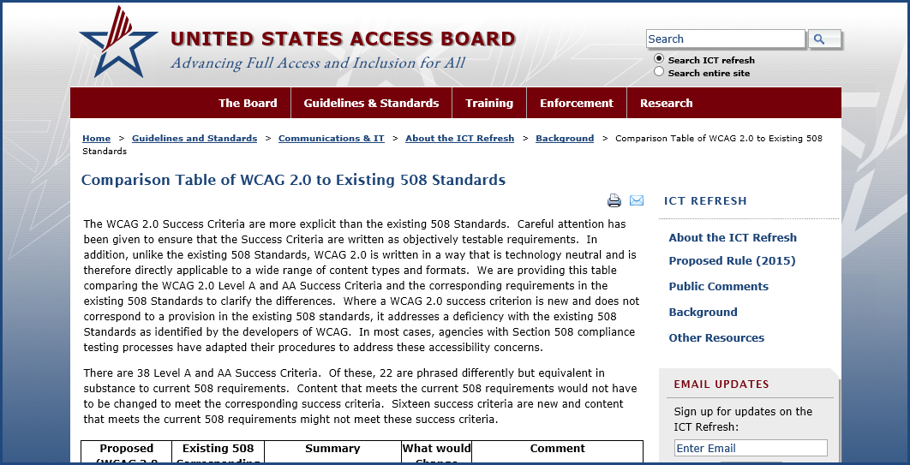
Access Board’s WCAG 2/508 Comparison Table
Comparison Table of WCAG 2.0 to Existing 508 Standards:
www.access-board.gov/wcag2-508

Slide 8
WCAG 2.0 is Applicable To…
Web Content
  Level AA
  Includes Web Applications
Documents
  Level AA, minus four SC for “within a set of web pages”:
    2.4.1 Bypass Blocks
    2.4.5 Multiple Ways
    3.2.3 Consistent Navigation
    3.2.4 Consistent Identification
  Includes Support Documentation
Software
  Level AA
    Minus four SC for excluded for Docs
  Includes Mobile Apps
  AT is Exempted
  Additional Provisions
    Non-Web Software
    Authoring Tools
    Media Players

Slide 9
Applying WCAG 2.0 to Documents and Software
Same as with Web Content:
Both Level A and Level AA Success Criteria
Includes WCAG 2 “Conformance Requirements”
  Conformance Level
  Full Pages
  Complete Processes
  Only Accessibility-Supported Ways of Using Technologies
  Non-Interference

Slide 10
Chapter Provisions for Documents and Software
Exceptions for four SC for “within a set of web pages”
  E205.4
  (electronic content)
  E207.2 (software), exception 2
Word Substitution when applying WCAG 2.0 to Documents and Software
  E205.4.1
  (electronic content)
  E207.2.1 (software)

Slide 11
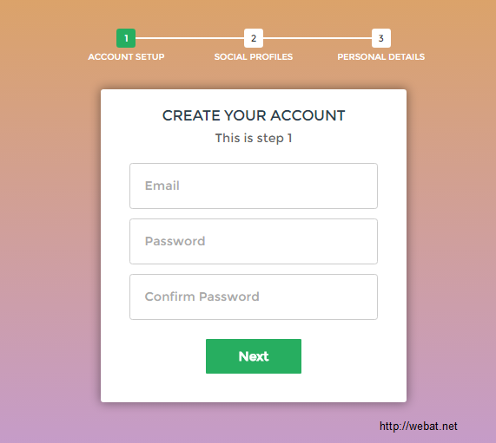
Complete Processes
WCAG Conformance Requirement #3 for “Complete Processes” does applies to Software:
But not be a simple word substitution, so…
  E207.2 Exception 3
  E207.3 Complete Process for Non-Web Software

Slide 12

New E202 General Exception (Safe Harbor)
E202.2 Legacy ICT
(Safe Harbor)
  Any component or portion of existing ICT that complies with an earlier standard … and that has not been altered on or after January 18, 2018, shall not be required to be modified to conform to the Revised 508 Standards

Slide 13
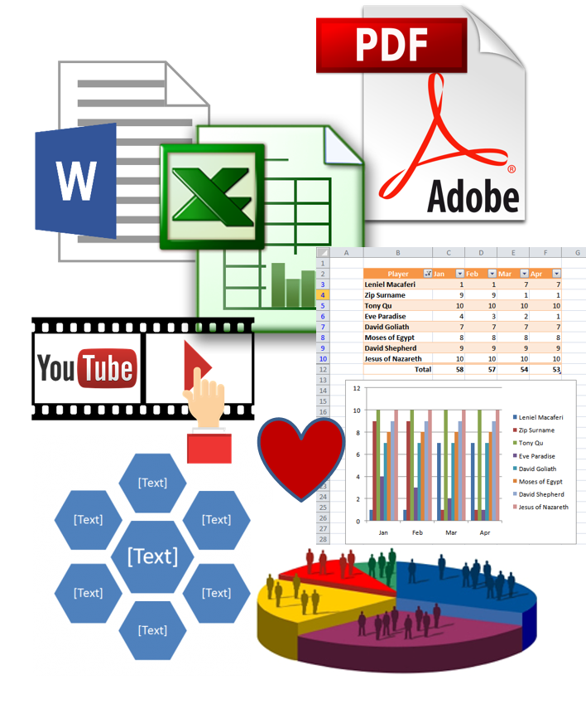
ICT Authoring Tools
Authoring Tool. Any software, or collection of software components, that can be used by authors, alone or collaboratively, to create or modify content for use by others, including other authors.

Slide 14
Examples of ICT Authoring Tools
Software for:
  authoring/editing digital content (Word, Excel, PPT, Acrobat, etc.)
  converting digital content ("Save as HTML“, “Save as PDF”, etc.)
  web content authoring/editing (WYSIWYG HTML: Dreamweaver)
  updating portions of web pages (blogs, wikis, online forums)
  live collaboration
  creating mobile web applications
  generating/managing entire web sites (WordPress, etc.)
  digital publishing authoring/editing (ePub, eBooks, e-zines, etc.)
  authoring/editing social media and multimedia
  scripting libraries
  web application frameworks (IDEs and SDKs)
  digital content management (CMS, LMS, etc.)

Slide 15
Section 508 and WCAG 2.0

Slide 16
Why Use WCAG 2.0? (Page 1)
WCAG 2.0 Support Documents are Update-Able
  Deliberative professional and public vetting process
WCAG 2.0 is an International Standard
  W3C Standard in 2008
  ISO Standard in 2012: ISO/IEC JTC-1 40500:2012
In Use in Many Countries and Governments
  Canada, Australia, New Zealand, Japan, Israel, elsewhere
  Adopted in EU in April, 2015 (Mandate 376)
  Formal translations (18 so far)
In Use Around the World in Industry
  Banking, Retail, Education, Business, Entertainment, Travel, etc.

Slide 17
Why Use WCAG 2.0? (Page 2)
Technology Neutral
  unlike 1194.22, it is not HTML specific
Requirements (a.k.a. SC) are all yes/no statements
Requirements are Objectively Testable
Includes some Cognitive, Language, and Learning (CLL)
Requirements very discrete and MOSTLY don’t require significant subjective expert judgment to evaluate…

Slide 18
Why Use WCAG 2.0? (Page 3)
Built-in Prioritization Path/Plan
(for Development/Remediation/QA)
  4 Conformance Non-Interference Requirements SC (Showstoppers) (all Level A) If these 4 SC do not pass, then very few PWD will even be able to use the ICT:
    1.4.2: Audio Control (must NOT allow automatic playing of sounds – which over-rides screenreader audio track)
    2.1.2: No Keyboard Trap (KB only user control)
    2.2.2: Pause, Stop, Hide (user control, prevent seizures)
    2.3.1: Three Flashes or Below Threshold (prevent seizures)
  Level A SC (Lowest Level: provides Minimum Access)
  Level AA SC (2nd Level: provides Greater Access)

Slide 19
WCAG 2.0 for Section 508: Overview

Slide 20
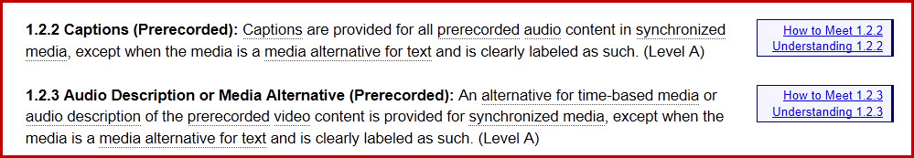
WCAG 2.0: Documents & Resources
Standard (Normative: Cannot Change)
  Web Content Accessibility Guidelines (WCAG) 2.0 (the WHAT)
Supporting Documents (Non-Normative: Can Change/Update)
  Understanding WCAG 2.0 (the WHY) (links from WCAG 2)
  How to Meet WCAG 2.0 (Quick Ref) (the HOW) (links from WCAG 2)
  WAI Tutorials (the HOW)
  Techniques for WCAG 2.0 (the HOW)
  WCAG2ICT (Software & Documents) (the HOW)
  + More Supporting Documents and Tools…..

Slide 21
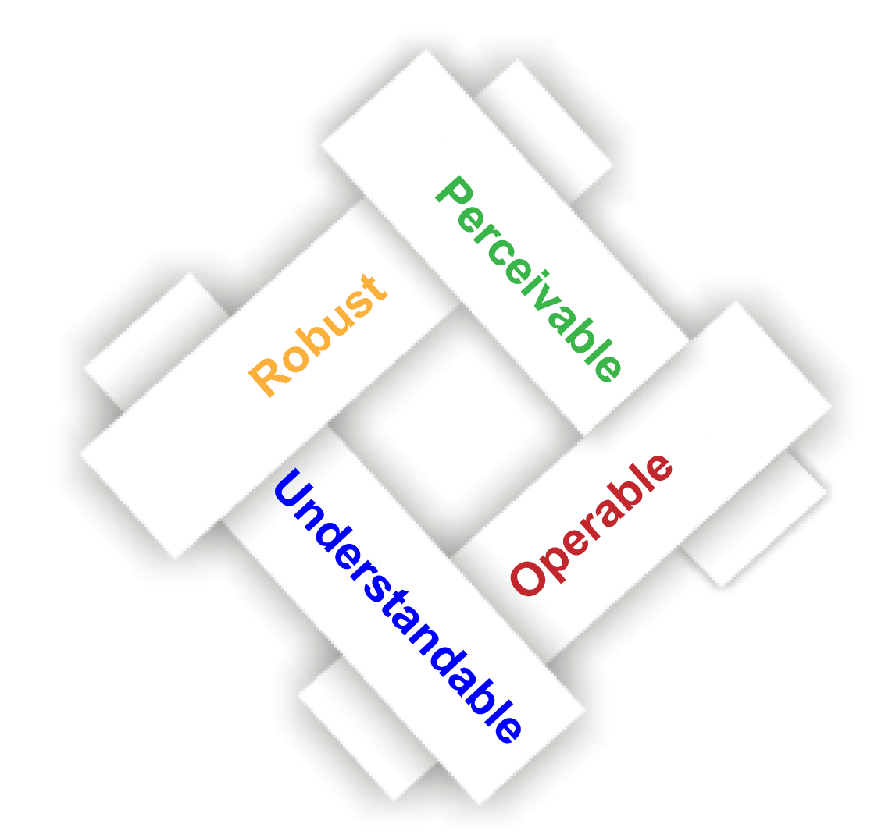
WCAG 2.0: POUR Concept
The 4 Principles
POUR’s Overlapping Tenets
Perceivable
Content is made available to the senses - sight, hearing, and/or touch
Operable
Interface forms, controls, and navigation are operable
Understandable
Content and interfaces are understandable
Robust
Content can be used reliably by a wide variety of user agents, including assistive technologies

Slide 22
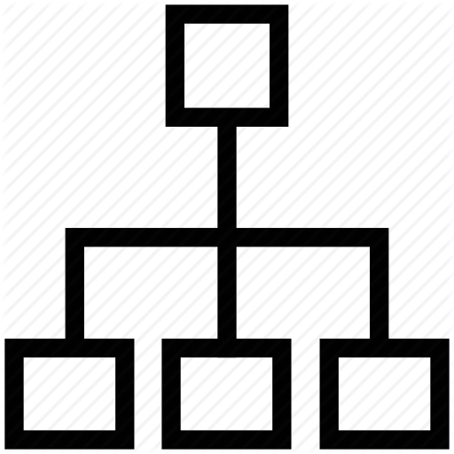
WCAG 2.0: How the Standard is Structured
What is it made up of? What is in it?
4 Principles
  12 Guidelines
    38 Success Criteria (Requirements)
      25 SC at Level A
      13 SC at Level AA
      24 SC at Level AAA (Not Required
      for Section 508/ADA – not counted)
Links to Hundreds of Techniques
and Failures (Not Required)

Slide 23
WCAG 2.0: 4 Principles, 12 Guidelines
1. Perceivable
  1.1 Provide text alternatives for any non-text content so that it can be changed
    into other forms people need, such as large print, braille, speech, symbols or simpler language.
  1.2 Provide alternatives for time-based media.
  1.3 Create content that can be presented in different ways (for example simpler layout)
    without losing information or structure.
  1.4 Make it easier for users to see and hear content including separating foreground from background.
2. Operable
  2.1 Make all functionality available from a keyboard.
  2.2 Provide users enough time to read and use content.
  2.3 Do not design content in a way that is known to cause seizures.
  2.4 Provide ways to help users navigate, find content, and determine where they are.
3. Understandable
  3.1 Make text content readable and understandable.
  3.2 Make Web pages appear and operate in predictable ways.
  3.3 Help users avoid and correct mistakes.
4. Robust
  4.1 Maximize compatibility with current and future user agents, including assistive technologies.

Slide 24
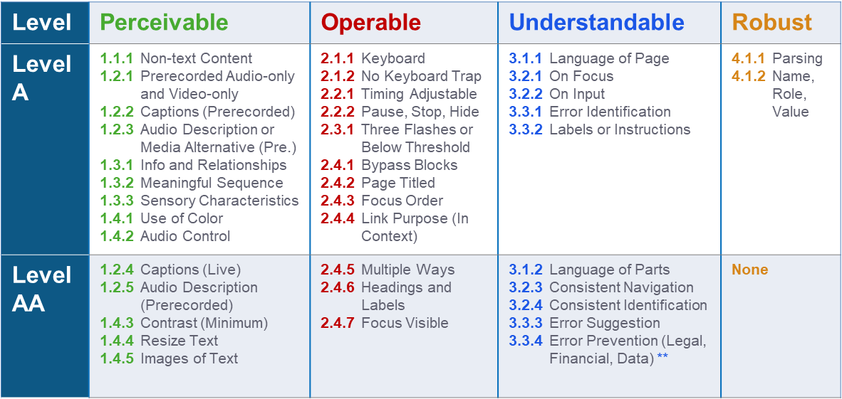
4 Principles, 38 Success Criteria (A+AA Requirements)

Slide 25
What Do the SC Levels and Conformance Mean?
Conformance Level: One levels of conformance is met in full.
Level A: (lowest/minimum)
  Content satisfies all the Level A SC, or a conforming alternate version is provided.
  Has the highest impact on the broadest array of user populations
  (highest degree of user impact), and has the lowest impact on the presentation and business logic of the site. Easier for developers.
Level AA: (higher)
  Content satisfies all the Level A and Level AA SC, or a Level AA conforming alternate version is provided.
  Higher Bar. Has a high impact for specific user populations, and may impose more changes to the presentation or business logic of the site. Requires an additional level of effort for developers.
Level AAA: (highest)
(Not applicable to Section 508/ADA)
Conformance Claims: Are optional, and, there are NO plans to require Conformance Claims in the New 508 Standards.

Slide 26
Key Concepts to WCAG 2 Accessibility
There are two concepts that must work together to ensure that information can be presented to the user of AT in an Accessible manner.
Authors must rely only on using technologies that are accessibility-supported (via AAPIs) - and -
Authors must use those technologies properly in order for the content to be programmatically determinable - and hence presentable, by AT (and user agents) to users with disabilities

Slide 27

1. Accessibility Supported
Accessibility Supported
Technology Used: MUST Work with AT & Accessibility Features of OS and UA (via AAPIs):
Using a technology in a way that is “accessibility supported” means choosing technologies that render and deliver content in such a way that is known to work with AT and the accessibility features of operating systems,
browsers, content players,
for an intended environment
(internet, intranet, application,
native app).

Slide 28

2. Programmatically Determinable
Programmatically Determinable
Content: MUST Work with AT: Five SC require that content must be "programmatically determinable." This means that the content is authored in such a way that user agents, including assistive technologies, can access the information.
  1.3.1: Info and Relationships
  1.3.2: Meaningful Sequence
  3.1.1: Language of Page
  3.1.2: Language of Parts (AA)
  4.1.2: Name, Role, Value

Slide 29
Success Criteria: What are They?
Success Criteria ARE the Requirements of WCAG 2.0
They are outcome based, and must be testable
They are like the Section 508 provisions .22 (a)
They are more detailed than old Section 508 provisions
They cover vital things that WCAG 1 and Original Section 508 missed
They are prioritized (Conformance SC, Level A, Level AA)
They will be part of the components in your new VPATs/GPATs
There are 38 combined Level A and Level AA SC

Slide 30
WCAG 2.0 for Section 508: Success Criteria

Slide 31
NOTE: Success Criteria are “Applicable To…”
Web: When we say “Applicable to: Web…” this includes:
  Web Sites
  Web Content
  Web Applications (Apps)
  Web Documents (rendered through a browser)
  Mobile Content and Apps (rendered through a browser)
Web, Software and Non-Web Documents:
When we say “Applicable to: Web, Software and Non-Web Documents” this means - literally - WCAG 2 applies as written to:
  Web (as identified above)
  Software, including Native Apps
  Documents (that are not rendered through a browser)
  Software and Non-Web Documents with Closed Functionality
  WCAG2ICT: You will see some SC below with “(Developers will adapt SW
  and NWD for Closed Functionality products).” This means the SC is still applicable to Software and Non-Web Documents overall. This merely is a NOTE (specifically related to Closed Functionality aspects/products ) – that developers will need to adapt the
  Language and Methods used to address that SC’s functionality and criteria.
  Because: AT usually cannot be connected to Closed ICT products.

Slide 32
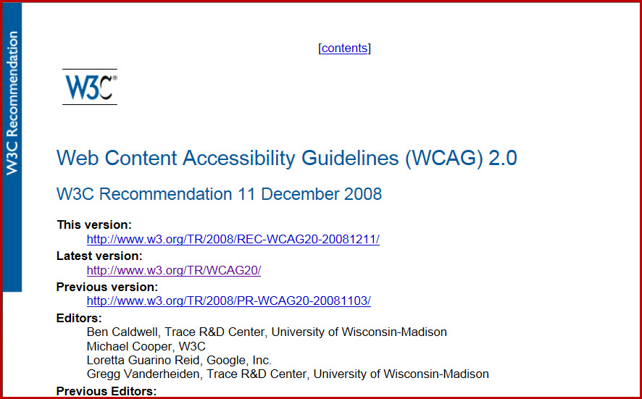
WCAG 2.0 Standard (the WHAT: Screenshot)

Slide 33
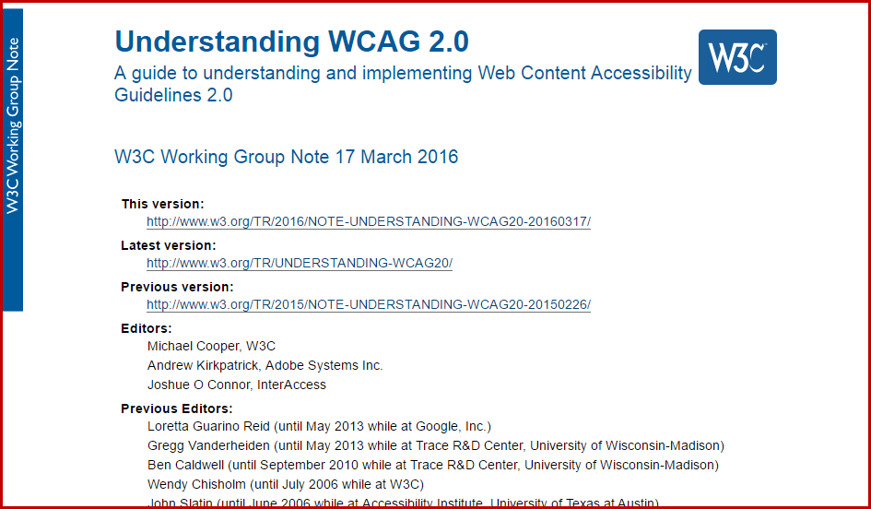
Understanding WCAG 2.0 (Screenshot)

Slide 34
Understanding WCAG 2.0 (the WHY: document)
A Guide to Understanding and Implementing WCAG 2.0
www.w3.org/WAI/GL/UNDERSTANDING-WCAG20/
Updated Regularly
Intent of each Success Criterion
  Including who Benefits
Plain Language Examples
  Where might the SC apply?
Links to Related Resources
  Further reading off the W3C WAI site
Links to Model Techniques and Failures
  Many are quite technical and detailed

Slide 35
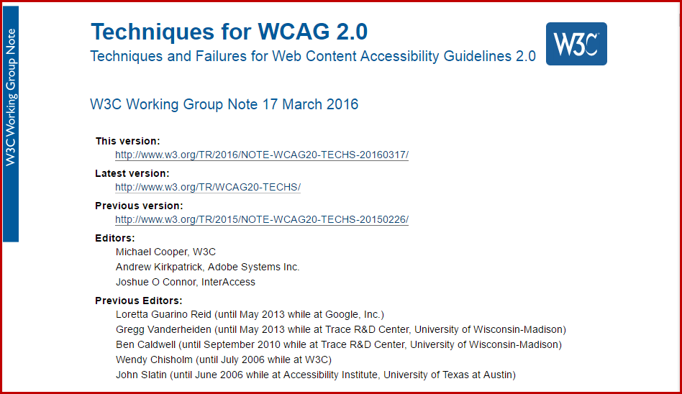
Techniques for WCAG 2.0 (Screenshot)

Slide 36
Techniques for WCAG 2.0 (the HOW: document)
Techniques and Failures for WCAG 2.0
Naming Convention
  Example: H51: means the 51st HTML technique developed
Types of Techniques
  WCAG 2.0 Sufficient Techniques are not the only sufficient techniques and should never be required as the only way to meet WCAG 2.0 success criteria.
  WCAG 2.0 Advisory Techniques should always be considered but are not sufficient.
  WCAG 2.0 Failures are designed to always indicate a failure.
IMPORTANT: Techniques are great, BUT, they should NEVER be Required
If "WCAG 2.0 Techniques" are required by government regulations or rules as the only techniques that will be accepted as sufficient to meet the SC,
  Then, it will be a violation of those regulations or rules to use any New Technologies from any company or standards group for perhaps several years after those technologies are introduced to the public – until which time the W3C has time to learn the new technology, write techniques, and then to update the Techniques document.

Slide 37
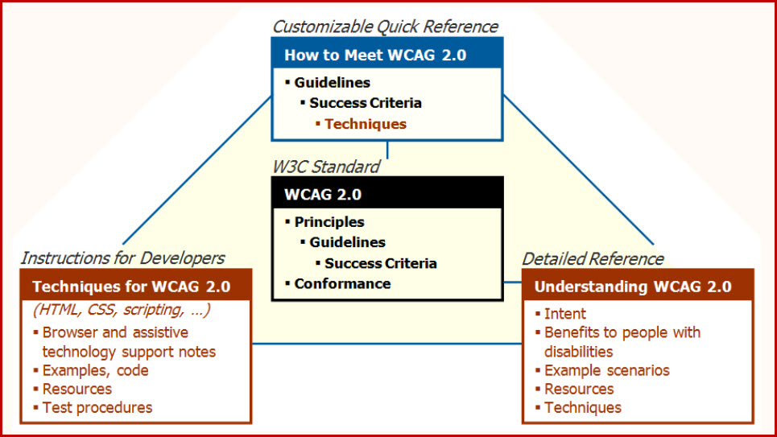
Illustration of How the WCAG 2 Docs Inter-relate

Slide 38


How to Meet (Quick Ref)

Slide 39
How To Meet WCAG 2.0 (the HOW: document)
How To Meet WCAG 2.0: Quick Reference
is the go-to document for the day-to-day Developer
URL: www.w3.org/WAI/WCAG20/quickref/
Updated Regularly
Actually a Database (of Techniques and Failures)
Two Names “How To Meet WCAG 2.0” was “Quick Reference”
Customizable
Robust Filters (Role, Topic tags, Levels, Techniques, and Technologies)
Progressive Levels of Detail via Show/Hide
Practical ways to get to the Techniques and Failures

Slide 40
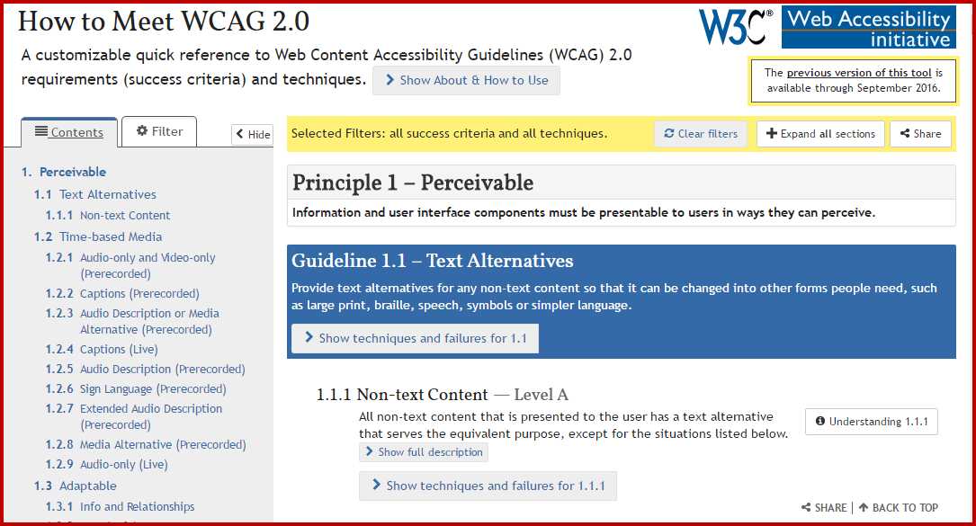
How To Meet WCAG 2.0 (Screenshot)

Slide 41
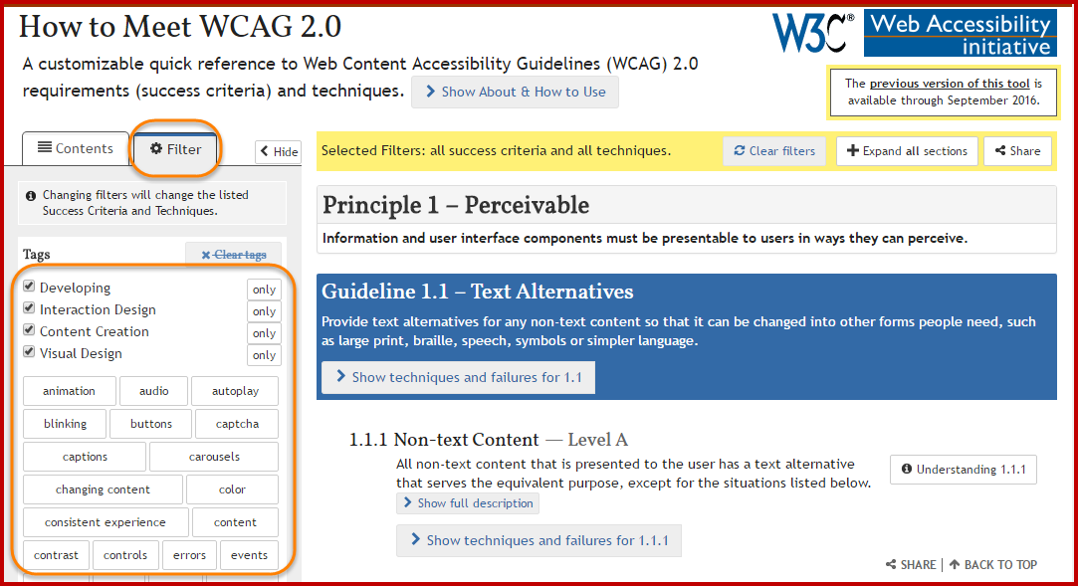
How To Meet WCAG 2.0: Filter View (Screenshot)

Slide 42

Summary

Slide 43
WCAG 2.0: Virtual Takeaways
The Success Criteria ARE the Requirements
The Techniques are NOT required but provide guidance
The SC are outcome based, and must be testable
Section 508 requires Level A and Level AA SC
The SC will be part of your new VPATs/GPATs
SC are prioritized (Conformance SC, Level A, Level AA)
There are 38 combined Level A and Level AA SC
WCAG 2.0 Support Documents are Regularly Updated
Chosen Technologies & Content must Work with AT
(PD & AS)
Use W3C Resources to Build and Test Content

Slide 44
WCAG 2.0: POUR Principles
Keep the 4 Design Principles in Mind.
POUR
  Perceivable
  Operable
  Understandable
  Robust

