Slide 1
VA Puget Sound Health Care System Seattle, WA SUMMER RESEARCH PROGRAM
JOIN US for an 8–12-week Summer Research Program (SRP) in biomedical/healthcare research at the VA!
Who is the SRP for?
2- or 4-year college students on a health science/professional track (must have completed at least 1 year of college)
OR
Health professional students or medical trainees/fellows/residents (must have completed at least 1 quarter or semester)
Must be a U.S. Citizen
The SRP seeks to expand your knowledge and/or capacity for:
Biomedical/healthcare career availability within the VA
Disparities in biomedical research & healthcare delivery
Hands-on exposure to translational & transdisciplinary research
Professional development in the biomedical/healthcare workforce
Fruitful mentorship to future biomedical/ healthcare professionals
For inquiries, contact an SRP Director: Lindsey Anderson, PhD; lindsey.anderson5@va.gov OR Jose Garcia, MD, PhD; jg77@uw.edu

Slide 2
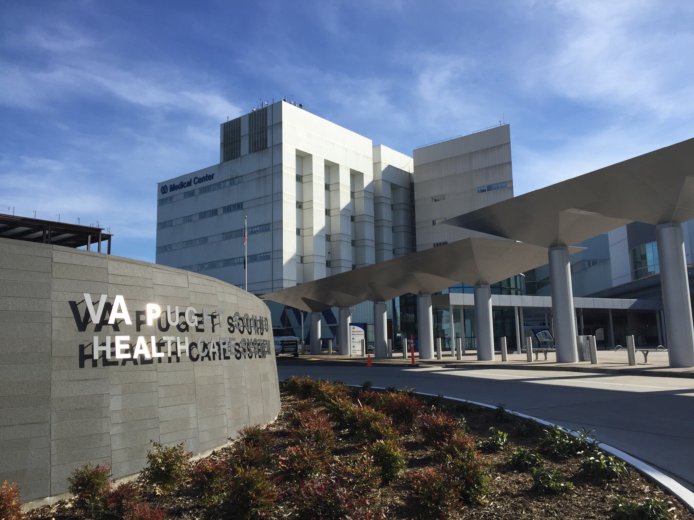
Summer Research Program Experience
Technical skill development: You may be exposed to state-of-the-art approaches to address datasets from high-throughput assays, quantitation of body composition from image-based gold standard technology, and measurement of real-time mitochondrial respiration. You may also be introduced to common techniques for biochemistry/molecular biology and common assessment tools for functional performance and patient-reported outcomes.
Web-based learning modules: Select from an array of 100+ online modules for discussion during peer group meetings. This self-guided strategy supports a tailored approach to address trainees’ diverse backgrounds, perspectives, and interests. Topics include, but are not limited to:
Career/professional development
Disparities in research studies, the scientific workforce, or healthcare delivery
Responsible conduct of research including the NIH emphasis topics “rigor and reproducibility”
Faculty mentorship: Attend lab meetings in your mentors’ research laboratory to gain exposure to lab/personnel management and maintain regular meetings to discuss learning modules, progress/obstacles toward achieving SRP goals, & other topics including, but not limited to:
VA Puget Sound Health Care System
(VAPSHCS) in Seattle, WA
VAPSHCS serves 80,000+ Veterans in the culturally, racially, and socio-economically diverse Pacific Northwest.
The VAPSHCS is affiliated with the University of Washington School of Medicine, the only medical school directly serving Washington, Wyoming, Alaska, Montana, and Idaho.
This strong, diversified base of support has ensured a robust research program with 600+ active projects and VAPSHCS ranks 8th in funding among VAs.
VAPSHCS SRP Overview
Applications will be reviewed as received and strong submissions will be invited for an interview. Final selection will be based on application, research interest, and mentor/project needs. Compensation is provided.
Trainees will work on a project under direction of a faculty mentor, postdoctoral fellow, or other experienced lab member until comfortable, and will then work independently.
The SRP is a full-time, in-person 8–12-week experience starting May/June through August/Sept with mentorship continuing as needed over the following academic year.
Choosing a school/specialization/mentor
Preparing a competitive application
Work/life balance and maintaining productivity
Biomedical/healthcare career paths within the VA
Self-advocacy, leadership, and overcoming adversity in academia
Journal club (manuscript preparation vs. review, responding to reviewer critiques)
Study design (pre-clinical vs. clinical, translational, transdisciplinary, collaborations, regulatory/admin issues, statistics, etc.)
Grant writing (generating preliminary data, funding mechanisms, budgeting, etc.)
Enhancing professional visibility, networking, and professional societies
Healthcare policymaking and financing
Practical skill development: Observe a spectrum of translational data types from animal to benchwork to clinical, including data protections and repository maintenance. Learn about clinically relevant endpoints and gain exposure to patient charts and data extraction. Trainees will gain the critical experience of synthesizing data for presentations and oral communication of scientific findings. Also learn how different types of writing are incorporated into personal statements, resumes/CVs, and reference letters.
Social activities: With mentors, peers, and lab-mates, attend a trip to a Seattle museum/center promoting education of disparities in healthcare and/or health science.
At the end of the SRP: Submit an Individual Development Plan with 1-, 5-, and 10-year professional and personal goals. Trainees will be encouraged to consider mentorship goals, like diversifying their faculty mentor relationships or facilitating new peer-mentoring relationships. Trainees will also give a 30-minute presentation to faculty mentors and peers; their work will be highlighted at the VAPSHCS Annual Research Week.

