Slide 1
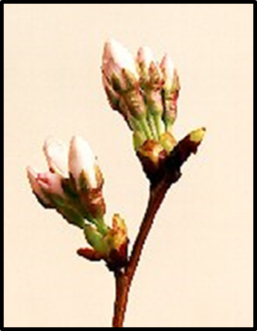
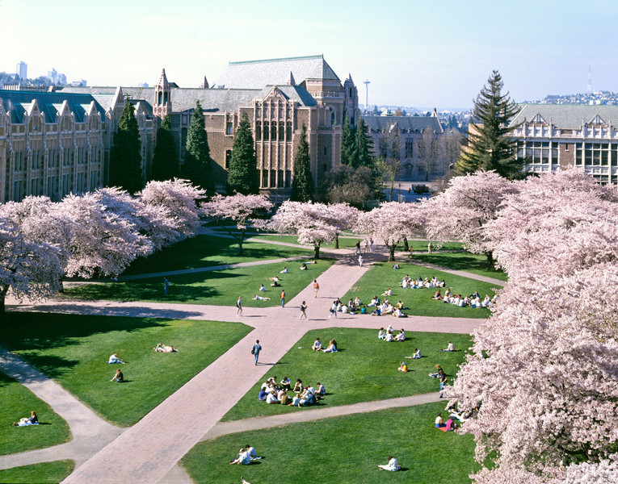
Research Volunteer
Opportunity:
Phenology of Cherry Blossoms at the University of Washington
Announcement
Volunteer opportunities are available for students interested in exploring the phenology of cherry tree blossoms at the University of Washington. Interested students will gain experience working in ArcGIS and will gain knowledge about the biology of cherry trees.
Project Description & Duties:
Grounds Management at the University of Washington in
partnership with a graduate student from the School of Environmental and Forest Sciences will be tracking the different stages of cherry tree blossoms in order to create models to better predict the peak bloom period of cherry trees at the University of Washington.
Schedule and time commitment:
The work is field based, and a weekly schedule will be discussed upon hire. Preferably multiple 30 minute shifts during the week.
Requirements: A background in biology or a related discipline is desirable.
How to Apply: Send an email of interest and resume to: Marlee Theil, mtheil@uw.edu UW School of Environmental and Forest Sciences

